Slide 1

JAYOTI VIDYAPEETH WOMEN’S UNIVERSITY
( Jaipur)
An International Conference
on
"Recent Engineering Trends in Community Development and Women Participation-II"
ETCDWP-2019
TOPIC:A SURVEY ON MECHANISM OF MECHANISM OF FRIENDLY ROBOTICS
JV’n Divyanshi goyal

Slide 2

CONTENT
♦ Abstract
♦Introduction
♦Conclusion

Slide 3
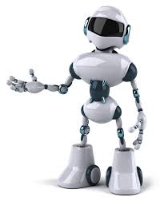
A SURVEY ON MECHANISM OF FRIENDLY ROBOTICS

Slide 4
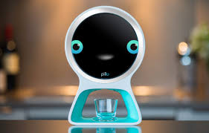
ABSTRACT

Slide 5
In recent world discovered a different type of robots. A mechanism of friendly robotics. There are several potential factors for motivate robot with human beings such that behaviour, contact, safe operator, etc. Robot perform different type of activities like modelling, robot control, target trackers, localization, and assembly. Robot desire to help the people to become more independent and satisfied various field.
.

Slide 6

INTRODUCTION

Slide 7
Robotics used for automating processes in different factories. From the beginning 1970s, robotics factories led their employment. Robotics has some changing to do work. This type of article based on robotics has no concerned for longer time.

Slide 8
CONCLUSION
The past area introduced divers well being measurements also security related issues in mechanical structure, activities and controller plan of local robots. Despite the fact that mechanical and controller sub systems are default with independent in this paper, it is critical to take of security like wise release upon the cooperation between segment.

Slide 9
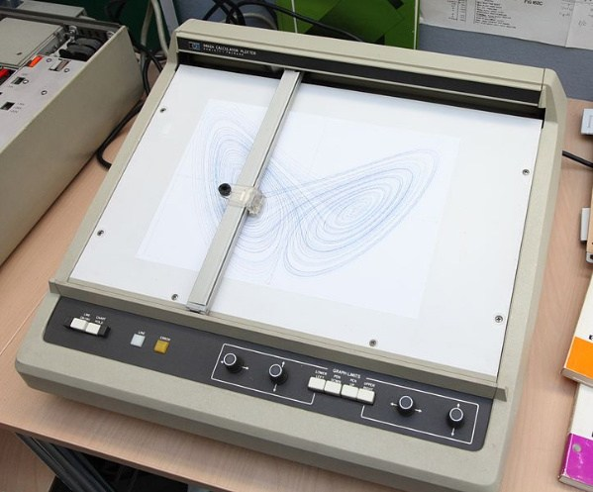
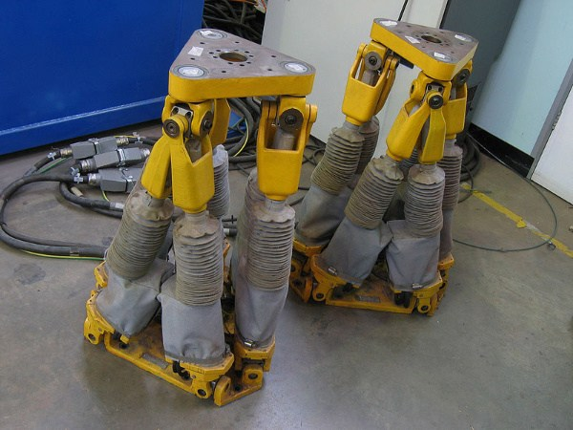
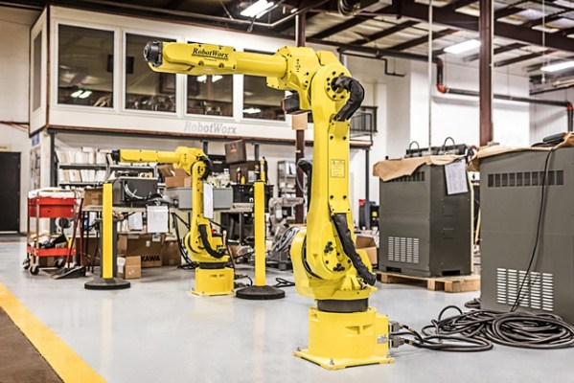
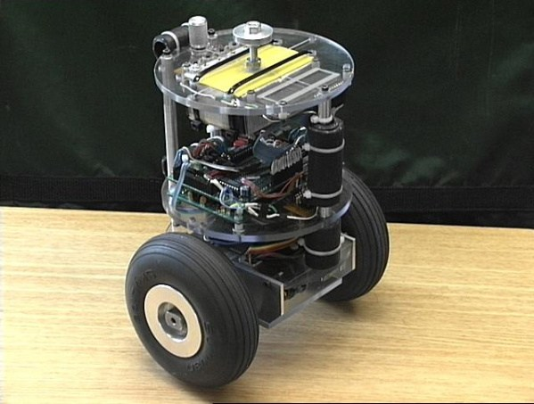
Different type of robotics

Slide 10
THANK YOU

